Slide 1
Relational Model

Slide 2
Database Structure

Slide 3
Table
relational database stores all data in tables
single table -> repeating data
waste of space
data consistency issues

Slide 4
Normalization
“is the process of reducing redundant information in a database”
data retrieval as well as modification is more efficient
data redundancy is minimized, which simplifies maintenance and reduces storage

Slide 5
The three normal forms
Normal form | Description
First (1NF) | The value stored at the intersection of each row and column must be a scalar value, and a table must not contain any repeating columns.
Second (2NF) | Every non-key column must depend on the entire primary key.
Third (3NF) | Every non-key column must depend only on the primary key.
Notes
Each normal form assumes that the design is already in the previous normal form.
A database is typically considered to be normalized if it is in third normal form.

Slide 6
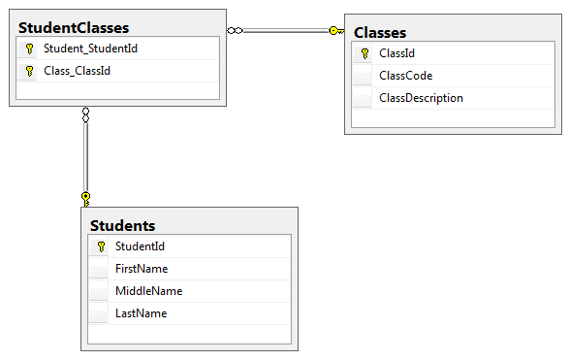
Normalized Database - Design

Slide 7
Normalized Database - Data

Slide 8
Tables
all data stored in tables
one entity per table (usually)
data as well as relationships
rows
each rows contains a single record
columns
each column contains a single attribute of the entity
cell
intersection of a row and column

Slide 9
Relationships & Keys
relationships between tables
associations between entities
maintained via primary/foreign keys
primary key
uniquely identifies the row
composite primary key – multiple columns, single key
foreign key
a key that references a primary key in a different table

Slide 10
Relationship Types
three types of relationships
one-to-one
e.g. employee & address
one-to-many
e.g. student & address
many-to-many
e.g. students & courses
linking table (enrollment)

Slide 11
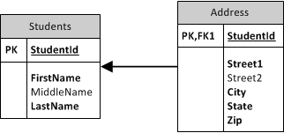
One to one example

Slide 12
Many to many example
break 1 many-to-many relationship (Classes & Students) into 2 one-to-many relationships, using a linking table (StudentClasses)

Slide 13
SQL

Slide 14
SQL
Structured Query Language
database programming language
a number of implementations – Oracle/SQL Server/MySQL
ignores white space (line breaks, spaces, indentation)
commands are NOT case sensitive
; ends the statement
string value is enclosed in single quotes ‘myText’

Slide 15
Basic Data Commands
get data:
SELECT * FROM MyTable;
insert data:
INSERT INTO MyTable (Column1, Column2)
VALUES (‘value1’, ‘value2’);
update data:
UPDATE MyTable
SET Column1 = ‘value3’
WHERE Column1 = ‘value2’;
delete data:
DELETE
FROM MyTable
WHERE Column1 = ‘value3’;

Slide 16
Clauses
WHERE (Select/Update/Delete)
narrow down which data you want to retrieve
ORDER BY (Select)
set the order of the data
GROUP BY (Select)
aggregate methods

Slide 17
Modifying DB structure/objects
all commands below apply to objects such as Database, Table, View, Stored Procedure, Functions, etc
CREATE
creates an object structure
ALTER
modifies the 0bject structure
DROP
removes the object structure, including any underlying data

Slide 18
Joins
allows you to join multiple tables into a single table (for example table1.column1, table1.column2, table2.column3, table2.column4 can be joined into a result set containing all 4 columns)
common joins:
inner join
outer joins – left, right and full
JOIN From Tables A and B
 | Matching A | All A
Matching B | INNER | LEFT OUTER
All B | RIGHT OUTER | FULL OUTER

Slide 19
Other

Slide 20
Entity Relationship Diagram (ERD) Final Project – IP, Summer 2002

Slide 21
CSE581 – Database Management
http://lcs-vc-mssql-01.ad.syr.edu/CSE581/Files

Slide 22
Database access in .Net

Slide 23
DB Access
ADO.Net
System.Data(.SqlClient)
DataSet, DataTable, DataRow, SqlConnection, SqlCommand, SqlDataAdapter
parameterized queries vs concatenation
Typed Datasets
typed tables/rows
Entity Framework
newest & best
code first/DB first/..

Slide 24
Entity Framework
code first approach
can generate DB from C# classes
can generate C# classes from DB
model (edmx)
not present in EF7
generated from DB
visual representation of design

